Slide 1
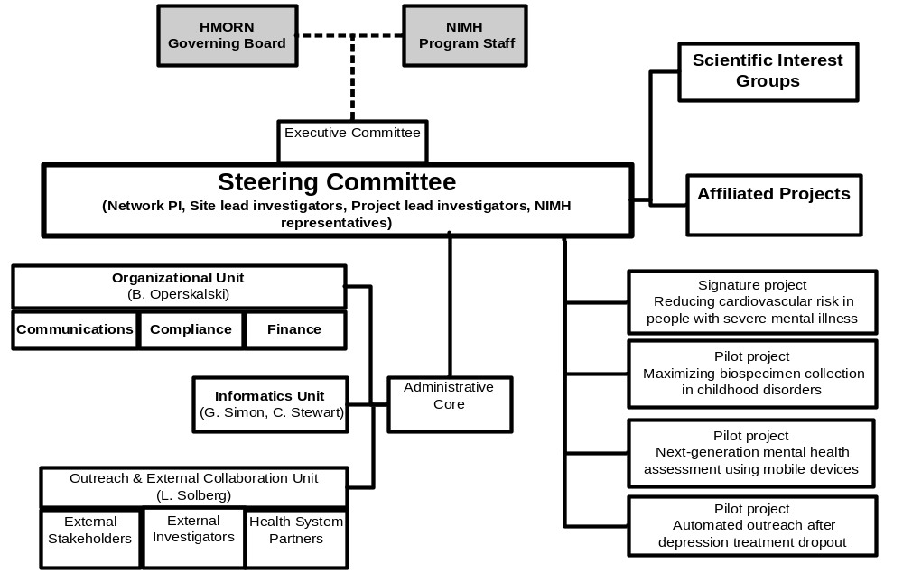
Official organizational chart

Slide 2
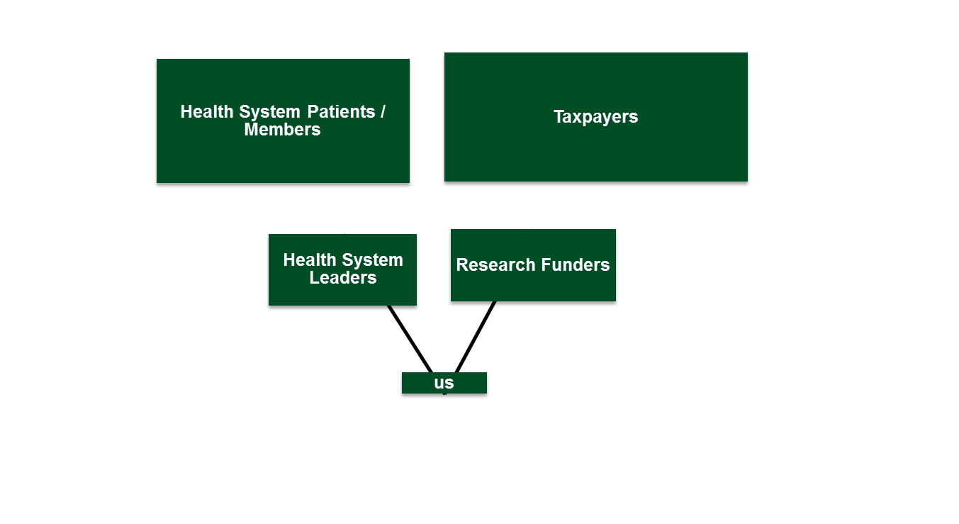
Real organizational chart

Slide 3
Different levels of engagement
Operational engagement: Help us do the work we already decided to do
Strategic engagement: What work should we do?

Slide 4
Patient Engagement as a Core Value in the Mental Health Research Network III
Karen J. Coleman, PhD
Kaiser Permanente Southern California
April 10, 2018

Slide 5
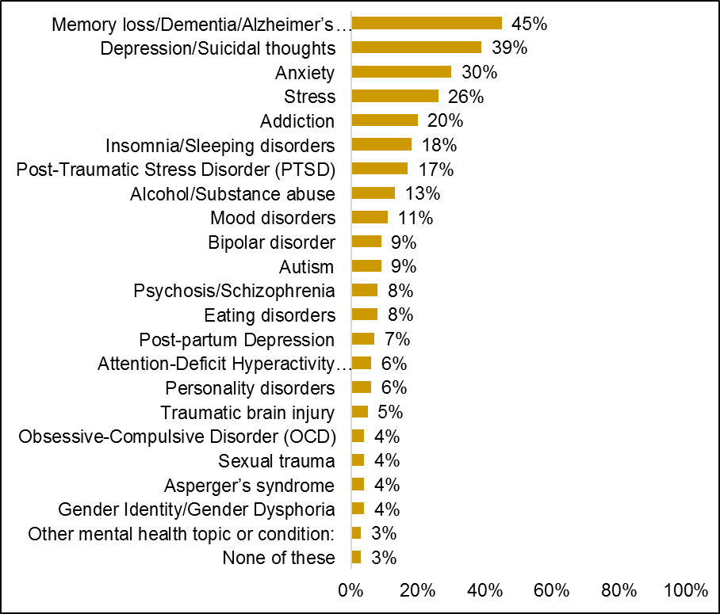
“Member Voice” used to ask patient members where they would like the health systems to focus most of their mental health research efforts. Responses from 368 patients are provided in Figure 1. This varied by age with younger adults more interested in depression/anxiety and suicide and older adults more interested in cognitive decline and dementia.
Health system leaders have conveyed the following priorities for mental health research: suicide prevention, feedback informed care, addressing the national healthcare quality metrics for depression monitoring, treatment, and outcomes,¹⁷ evaluating and improving the quality of psychotherapy, increasing access to mental healthcare, and evidence-based treatments for anxiety and depression in primary care settings.

Slide 6
PCORI Patient Engagement Award
National MHRN Strategy
  Two main partners: Community and Patient Partnered Research Network (one of the PCORnet PPRNs) and National Mental Health America
  Creation of a Stakeholder Collaborative Advisory Panel (SCAP)
    Three patient stakeholders from KPSC
    Theresa Nguyen, Senior Director/Vice President of Policy and Programs for NMHA
    Loretta Jones, Founder and CEO of Healthy African American Families
    Felica Jones, Director of Programs at Healthy African American Families
    Ken Wells, Principal Investigator for CPPRN
  Creation of a Patient Engagement Workgroup (TBD – reps from all MHRN sites)
Local KPSC Strategy
  Based upon the Patient Engaged Research Center at Henry Ford Health Systems
  Creation of the KPSC Mental Health Research Implementation Team (MHRIT)
    15 – 20 patients, caregivers, healthcare providers, and health system leadership
  Local partner is Healthy African American Families (core member of the Community Partners in Care initiative)

Slide 7
Goals of MHRN Patient Engagement
Short Term – Accomplished with Proposed Award
  Add the patient, caregiver, and family stakeholder voice and the community and advocacy groups who represent them to the national MHRN executive leadership team to develop a shared direction for the network and a shared national voice for mental health comparative effectiveness research (CER).
  Develop and pilot a strategy for stakeholder engagement within one MHRN-affiliated health system and the communities it serves to identify priorities for mental health CER.
  Develop and submit at least one new research proposal using the processes used in #1 and #2 at the end of the engagement award.
Long Term
  Institutionalize stakeholder engagement in strategic planning as a principle function of the MHRN.
  Disseminate specific strategies for stakeholder-engaged mental health CER across MHRN health systems.
  Develop and implement research proposals with stakeholder input at all phases of every MHRN-affiliated project.

Slide 8
Immediate Implications
Stakeholder Collaborative Advisory Panel (SCAP) members will be attending NIMH/MHRN meeting in November
Will need an additional whole day before the meeting for the orientation, sharing stories, and bonding – this will be run by Ken Wells, Theresa Nguyen, and Loretta Jones
NIMH/MHRN meetings will need to be structured somewhat differently to allow for meaningful stakeholder engagement
Building in and supporting stakeholder engagement for MHRN III

